Slide 1
Unit II: Levels of testing & special test
Unit testing
Integration testing
System testing
Acceptance testing

Slide 2
Unit testing
Testing that occurs at lowest level
Unit testing may be include code file , classes , methods which can be tested individually for correctness.
Drivers and stubs are written.
Perform following functions
1. tests all control paths.
2. ensure all statements executed at least once.
3.Test data structure.
4.Check range of i/ps

Slide 3
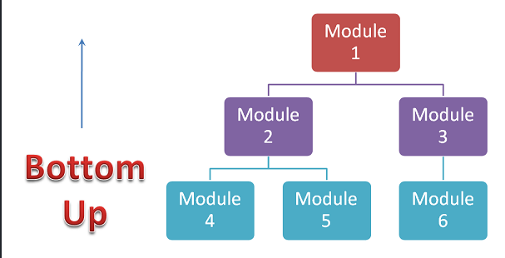
Driver 1
Module 2
Driver 2
Driver 3
Module 3

Slide 4
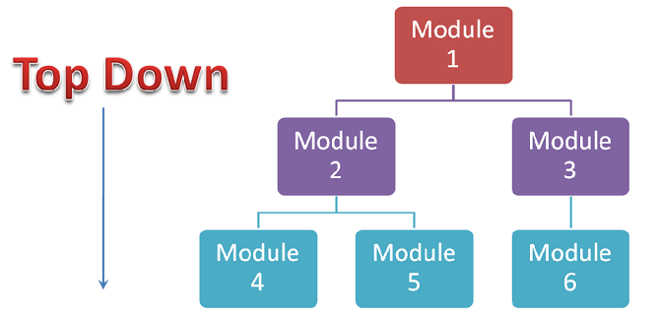
Module 2
Stub 2
Stub 3
Module 3
Stub 4
Stub 5
Stub 6

Slide 5
Driver:
simulate calling unit
Act as main program that accept test cases data , passes such data to the components and print result.
Driver: Calls the Module to be tested.
Used in bottom up approach
Stubs :
Simulate called unit
Act as sub module that are subordinate the components to be tested.
Dummy subprogram uses subordinate module interface , may do minimal data manipulation , print verification and return control to the tested module
Stub: Is called by the Module under Test.
Used in top down approach

Slide 6
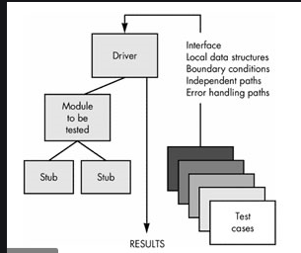

Slide 7
Example of Driver
Test driver software
Real World s/w
Test case data
result
Temperature data
result
F to C conversion module
F to C conversion module
Real world Configuration
Test driver configuration

Slide 8
Example of Stub….
Temperature Display Module Being Tested
Temperature Display Module
Tester Written Stub
Thermometer Interface Module
Real world Configuration
Test File of Temperature values

Slide 9
Advantage of unit test:
Find problem early in the development cycle
Basic understanding of units.
Disadvantage of unit test:
Initial time required for development
It will not catch integration errors

Slide 10
Driver
Stub
Emulating a calling function
Accept test case data and passes that data to the module that is being tested.
Use in bottom up approach
Emulating called function
Are used to replace modules that are subordinate to the module to be tested.
Use in top down approach

Slide 11
Integration testing
Performed against group of modules
Objective : take all tested individual modules, integrated them , test them again and develop s/w
Checks parameters passing between units.
Ensure that all modules work properly as per user requirements, when they are integrated
When multiple modules are integrated , problem must be in module interaction.
Advantage :
1. easy to fix the error compared to system testing

Slide 12
Integration testing
Top down
Bottom up
Bi directional

Slide 13
1. Top down integration
Testing begins from top level , progressively adds in lower level module one by one.
As low level code added , stub will replace with actual components.
It needs design and implementation of stubs, drivers may not be required ??

Slide 14
Advantage :
1. feasibility of program can be determine easily at very early stage
2. doesn’t require drivers.
Disadvantage:
1. unit are rarely tested alone before their integration ??
2. It become difficult to exercise the top level routines in the desired manner.?? Bcoz , low level modules are absent
3. stubs are required ??
Stubs are to be written and tested before they can be used in integrated testing.
4.It is difficult for other parties to perform this testing. Mostly developers will have to do it.

Slide 15
2.Bottom up integration
Testing starts at the atomic modules level
Each subsystem is tested separately and then the full system is tested.
Steps :
1. low level modules are combined into clusters (builds)that perform a specific s/w function.
2. drivers are written
3. build is tested
4. drivers are removed clusters are combined moving upward .

Slide 16
Advantage:
1. makes system more robust since each unit is tested first for its correctness.
2. doesn’t require stubs.
Disadvantage:
1. top level units are most important but tested last , pressure of delivery may cause problem of not completing testing

Slide 17
Bi directional integration
Follows top down , bottom up approach either simultaneously or one after another.
Sandwich overcome the shortcoming of top down , bottom up approaches.??
Steps :
1. bottom up testing start from middle layers and goes upward to the top layer.
2. top down testing starts from middle layers and goes downward.
3. big bang approach is followed for the middle layers . From this layers , bottom up approach goes upwards and top down approach goes downwards
Big Bang : where all the modules integrated together at once and tested.

Slide 18
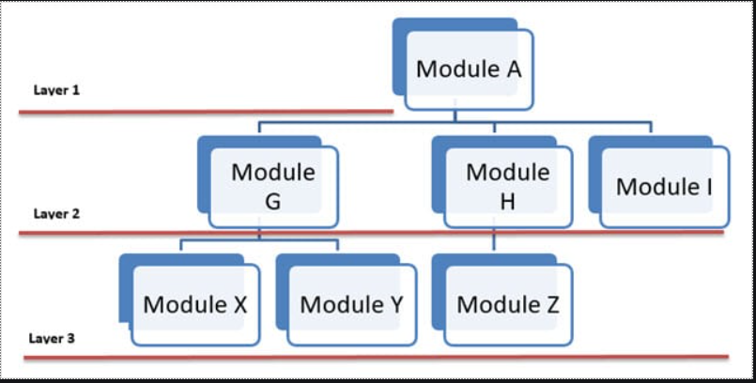
Bottom Up Approach
Big Bang Approach
Top Down Approach

Slide 19
Advantage :
1. suitable for very large project
2. overcome the short coming of T/D B/U approach.
Disadvantage:
1. cant use for project which has huge interdependence between different modules.
High cost.

Slide 20
SWB :Inspection , Walkthrough , Peer review
DWB : code coverage , code complex(flow graph) – consider one form
SBB : rqmts analysis :
DBB : positive / negative , boundary , equivalence – consider 5 forms

Slide 21
Testing on Web Applications 1. Functionality Testing :
Checking the behavior of the s/w application against specification.
Link testing : check different links on web page.
Visited link color , un visited link color , anchor link.
Web form testing :
-validation of form field , mandatory fields , check all possible operations , tab orders , default values field

Slide 22
2. Usability testing
Content testing:
No spelling or grammatical errors.
Avoid Dark color theme.
No broken images.
Navigation testing :
Menus , links , button
Navigation should be easy to use.
All options on header , footer left/right navigation should be consistent throughout the pages.

Slide 23
3. Compatibility testing
-non functional testing
-Browser compatibility test : web application should display properly on different browsers.
- OS compatibility : web application on different OS.
- Mobile browsing

Slide 24
4. Database Testing :
- check for data integrity.
-check for data consistent.
- correctness of data.
5. Interface Testing :
- should cover web server , application server , database server.
-web server : all web requests are accepting
-application server : request is sending correctly.
-database server : correct result return on request.

Slide 25
6. Performance testing :
-check response time under different speeds.
-check if site handles many simultaneous user request at same time.
- how web application sustain under peak load
7. Security testing :
- check if unauthorized access to secure page.
- check if accessing internal pages directly , required login then user should redirected to login page
- check if sessions are got expired after predefined amount of time.

Slide 26
System Testing
Recovery Testing
Load Testing
Security Testing
Stress Testing
Performance Testing
Usability Testing
Compatibility Testing

Slide 27
System testing
The system is tested against functional / nonfunctional requirements such as accuracy , reliability , speed defined by the s/w system specification.
IEEE defined system testing as ‘ testing conducted on complete integrated system to evaluate the system’s compliance with its specified requirement
Final testing done on a s/w system before it is delivered to the customer.

Slide 28
Advantage :
1. clearly specify how the application should behave.
Test system from user point of view.

Slide 29
Recovery testing
System is forced to fail in different ways to check whether the s/w recovers from failure without any data loss
Check how fast and better the application can recover against any type of crash
Example :
1. while application is running , suddenly restart the computer and check for data integrity.
2. while receiving data from n/w , unplug the connecting cable and plug back and analyze whether s/w continue receiving data from break point.
Advantage :
Less complaint and reduce maintenance cost.

Slide 30
Security testing
Attempt to verify that protection mechanisms built into a system will protect it from improper penetration.
Tester play the role of the individuals who desire to penetrate system.
It also aim at verifying below principle:
1. confidentiality 2. integrity
3. authentication 4. authorization
5. availability 6.non repudiation

Slide 31
Security testing techniques to protect s/w from following :
1.Spoofing identity:
stealing someone identity. Force application to use no authentication.
2.Tampering with data.
3.information disclosure.
4.DoS: s/w stop responding to valid request.

Slide 32
Performance Testing
Load Testing
Stress Testing
Soak Testing
Spike Testing

Slide 33
Performance testing
Non functional testing technique performed to determine the system parameters in terms of responsiveness and stability under various workload
Measure quality attribute such as reliability availability , resource usage.
Factors that governs performance testing:
1. throughput : capability of a product to handle multiple transaction in given period.
2. response time : delay between the point of request and first response
3. tuning : setting different values to the parameters of the product

Slide 34
Performance testing techniques
1.load testing: determine whether the system is capable of handling anticipated number of users or not.
2.Stress testing : determine how the system performs if current load goes beyond limits of its specified rqmts.
3. Soak testing : determine system parameters under continuous expected load.
test the system with expected or little more than the expected load for a long amount of time.
4.Spike testing : to determine whether the system will be able to sustain the workload.
testing is performed by increasing / decreasing the number of users suddenly and measuring performance.

Slide 35
Performance test process
1. Identify testing environment: details of h/w , s/w n/w configurations..
2. Identify the performance acceptance criteria:
Set performance bench mark which may not be present in specification.
goals and constraints for throughput , response time set.
3. Plan and design performance tests : simulate variety of end users.
4. Configuring test environment: prepare tools , resources.
5. Implement test design : create performance test cases
6. Run the tests: execute and monitor
7. Analyze , tune and retest

Slide 36
Load testing
Check whether system can perform well for specified load
You feed it all that it can handle
It involves simulating real life user load. It help in Identify maximum operating capacity of an application.
If number of users are increased then how much CPU , memory will be consumed , what is n/w and bandwidth response time.
Example:
1. downloading a series of large files from the internet.
2. server that can handle thousand of simultaneous connections , max out the capability.
3. running multiple applications on a computer or server simultaneously.
4. reading writing data to and from a hard disk continuously.

Slide 37
Advantages of load Testing:
1.Expose memory overflow bug.
2. prevent s/w failures bcoz it can predict how system will react when it is given large load .
3. measure performance of internet infrastructure.

Slide 38
Stress testing
IEEE , testing conducted to evaluate system beyond the limits of its specified rqmts.
Test cases are designed to execute the system in such a way that abnormal condition arise.
Limiting s/w to their bare minimum.
Running s/w under less than ideal conditions—low memory , low disk space , slow CPU.
Goal : ensure that s/w doesn’t crash in condition of insufficient computational resources.
Example :
1. running resource intensive applications in a single computer at the same time
2. infect system with viruses , trojans

Slide 39
Advantages of Stress Testing :
Indicate expected behavior of system when it reaches the extreme level.
Help to determine expected operating conditions and the failure conditions.

Slide 40
Load Testing
Stress Testing
Increasing the load on the system
Goal : expose defects related to buffer overflow ,
Help to determine reliability
Focus on response time
Measure performance based on volume of users
Overload the existing resources with multiple program execution.
Goal: analyze post crash report to define behavior of system after failure.
Help to observe stability
Focus on through put
Measure breakpoint of system

Slide 41
Soak Testing
Why do Soak Testing?
A system may behave normally when used for 2 hours, but when the same system is used continuously for 10 hours or more than that then it may fail or behave abnormally/randomly/it may crash. To predict such failure Soak Testing is performed.
memory utilization is monitored to detect memory leak (memory which is no longer needed is not released.)
short period of test doesn’t reveal Memory leak problems , but it will be reveal when test for a long amount of time.
Example :
When a bank announces that it will be closing, its system is expected to handle a large number of transactions during the closing days of the bank. This event is rare and unexpected, but your system has to handle this unlikely situation anyway.

Slide 42
Advantages of Soak Testing:
It spots the deterioration in performance, which could happen under high continuous load
It shows how sustainably the system runs over time.

Slide 43
Spike Testing
Is a performance testing type used to test software applications with extreme increments and decrements in load and determine recovery time after a spike of user load.
The goal of spike testing is to determine whether the system will fail or survive in case of dramatic changes in load.
Example Spike Testing Scenarios:
When an eCommerce store is launching special deals with great discounts such as on Black Friday.
When the certain content of a site goes viral over the Internet.

Slide 44
Advantages of Spike Testing:
Spike testing helps in maintaining the system under the extreme load.
Spike testing saves system or software application from crashing.
It reduces the chances of failure for the system or software application.

Slide 45
Client server testing
1. components testing.
--test client and server individually.
-- when server is tested , we may need a client simulator
--while testing client , need a server simulator.
-- test network by using client server simulator.
2. integration testing:
--after successful testing of server , clients , n/w , they are put together to form system and system test cases are executed.

Slide 46
Client server testing
Testing on client side (GUI testing)
-- cross platform nature: same GUI run transparently on different platform
--event driven nature: user action are events that determine application behavior.
Eg : application handles both mouse and keyboard as an alternate method of input

Slide 47
Testing on server side ( Application testing) :
Performance testing : when number of client are communicating with a server at a time , system performance is tested for maximum throughput.
Concurrency testing : multiple users may be accessing same records at a time , so concurrency test is required to understand response of a system.
Disaster recovery testing: test for disaster recovery and business continuity.

Slide 48
Acceptance testing
Formal testing conducted to determine whether s/w satisfies its acceptance criteria
Types of acceptance testing :
1. user acceptance test : validate by user
2. operational acceptance test: ensure process/procedures are in place to allow system to be used. Eg: checking backup facilities , procedure for disaster recovery , security procedure.
3. contract acceptance testing: system is tested against acceptance criteria as documented in a contract
4. compliance acceptance testing: validate against regulation to ensure it meets governmental, legal and safety standards.

Slide 49
Acceptance criteria
Definition : conditions that a s/w must satisfy to be accepted by a user.
List of requirements that must be satisfied perior to the customer acceptance.
Work at each stage of s/w development.
Starting from proposal stage till the point where the system is formally accepted by user
May be used as basis on which exit criteria for each phase and entry criteria of next phase may be defined.
Example : Designs must fulfill acceptance criteria so coding phase can start.

Slide 50
Alpha testing
Consider as internal acceptance testing in which End users test the s/w at developer’s site.
Assess the performance of s/w in the environment in which it is developed.
Users report the errors to s/w developers.
Advantage :
1. Simulate real time user behavior and environment ?
2.Early detection of errors ?
Disadvantage :
1. In depth functionality can not be tested
2. sometimes developers and tester are dissatisfied with result of alpha testing

Slide 51
Beta testing
Consider as external acceptance testing in which s/w sent out to a selected group of customers who use it in a real world environment.
‘live testing’ and conducted in an environment , which is not controlled by the developers.
Testing is performed without any interference from the developers.
Beta tests can be a good way to find compatibility and configuration bugs ??

Slide 52
Advantage of beta testing :
1. allow to test post launch infrastructure
2. reduces s/w failure risk via validation.
3. Improve product quality via customer validation
4. Increase customer satisfaction
Disadvantage of alpha testing:
1. test management is an issue ?
2. finding right beta users could be a challenge.

Slide 53
alpha testing
Beta testing
Performed at developers site
It involves white box black box testing
Requires lab environment
Ensure quality of product
Test in controlled environment
Performed at customer site
It Involves black box testing
Doesn’t require lab environment
Ensure product is ready for the real time users
No controlled environment

Slide 54
Special Test
Regression Testing
GUI Testing

Slide 55
Regression testing
Ensure that bug fixing doesn’t introduce errors.
Ensure that all code still work once code changes.
Changes doesn’t affect existing features.

Slide 56
Regression testing techniques
Retest all
Retest part of product
Retest based on prioritized test cases.
--selecting test cases based on:
- -frequent defect
- -verify core feature
- -function that has recent change
- -boundary value
- -failure test case(test to fail)
- -pass test case(test to pass)

Slide 57
GUI testing
Important??
How application handles keyboard , mouse events , and how menu bars , tool bars reacts to user input.
7 important traits common to good UI
1. follow standards and guidelines.
-- when to use check box instead of option
-- when to use warning , critical messages.

Slide 58
2. intuitive :
--functions be there when you expect them.
--easily get from one function to other.
--eg : move back button
-- remove excessive functionality that make s/w complicate.
3. consistent:
--Users have a habit that if they do something a certain way in one program , another will do the same operation in same way.
--Eg : in Notepad search→ find or F3
in word pad edit →find or Ctrl+F
--Shortcut keys and menu selection. Eg : F1 for Help
--Terminology and naming . Eg : find , search
--Placement of buttons : position of OK Cancel button

Slide 59
4. Flexible :
-- users like to select what they want to do , and how they want to do.
-- windows calc two views : 1. standard
2. scientific
--state jumping : more ways to complete same task.
-- data input / output : eg : to put text into a word pad → type , paste it , load it.
5. Comfortable :
---appropriateness: look and feel. Eg: financial business application should not have loud color , sound.
-- error handling : eg :warning before critical message
-- performance : eg: show progress through status bar

Slide 60
6. correct :
--Test whether GUI does what its supposed to do..
WYSIWYG :Eg: click on save button should saved document on disk.
Language &spelling
Bad media
7. Useful:
-- features actually valuable to s/w.

